Slide 1
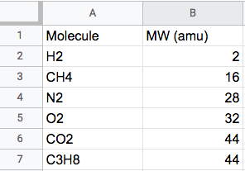
Entering numbers in a Google Spreadsheet
It’s very important to be organized, and one way to do that is to enter labels next to your numbers. In the example below, we’ve used column A to say what the molecule is, and column B to enter their molecular weights (MW). We also added a header (row 1), and specified the units of the MW.
Try it!

Slide 2
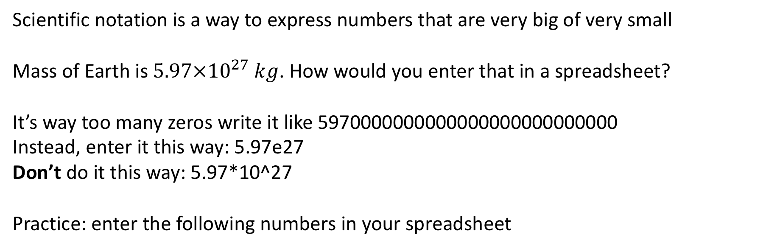
Entering numbers using scientific notation
Scientific notation is a way to express numbers that are very big of very small
Mass of Earth is $5.97×{10}^{27} kg$. How would you enter that in a spreadsheet?
It’s way too many zeros write it like 5970000000000000000000000000
Instead, enter it this way: 5.97e27
Don’t do it this way: 5.97*10^27
Practice: enter the following numbers in your spreadsheet

Slide 3
Entering numbers using scientific notation
Scientific notation is a way to express numbers that are very big of very small
Mass of Earth is $5.97×{10}^{27} kg$. How would you enter that in a spreadsheet?
It’s way too many zeros write it like 5970000000000000000000000000
Instead, enter it this way: 5.97e27
Don’t do it this way: 5.97*10^27
Practice: enter the following numbers in your spreadsheet

Slide 4
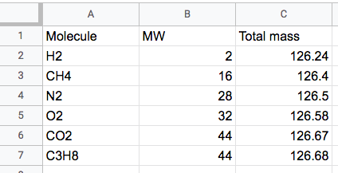
Using Google Sheets
We have some data that we’d like to visualize … so let’s do that

